Slide 1
Project Title : IOT Based Patient Health Monitoring on ESP32 Web Server
Course Code: | EE4103 | Course Name: | MICROPROCESSOR AND EMBEDDED SYSTEMS
Course Teacher: Prof. Dr. Engr. Muhibul Haque Bhuyan
Department of Electrical and Electronic Engineering
SL # | Students ID | Students Name | Program | Section
1 | 23-51242-1 | Md. Saikot Hossain | BSc in CSE | P
2 | 23-51259-1 | Md. Mosharof Hossain Khan | BSc in CSE | P
3 | 23-51260-1 | Rimal Banik | BSc in CSE | P
4 | 23-51269-1 | Md Rahidul Islam | BSc in CSE | P
5 | 21-44911-2 | Rahat Ahmed | BSc in CSE | P

Slide 2

Aims and Objectives of the Work
To develop a sensor interface
To implement a communication protocol
To incorporate data visualization
To analyze health data
To design an alerting mechanism
To simulate real-world scenarios
To test system reliability
To validate accuracy and effectiveness

Slide 3
Introduction
Background information
Traditional healthcare monitoring often relies on periodic visits to healthcare facilities, which may not capture real-time health fluctuations
Remote patient monitoring has emerged as a promising solution to bridge this gap by allowing continuous monitoring of vital signs from the comfort of the patient's home
IoT technology offers a scalable and cost-effective approach to implement remote patient monitoring systems, enabling real-time data collection and analysis

Slide 4
Introduction
Motivation
The system enables real-time health monitoring, leading to early detection of issues and improved treatment outcomes.
Remote monitoring allows patients, especially in rural or underserved areas, to receive timely medical attention without frequent hospital visits.
Continuous monitoring helps prevent complications, reducing the need for emergency care and lowering overall medical expenses.
By giving individuals access to their health data, the system promotes self-awareness and encourages proactive health management.
The collected health data can be used for medical research, policy development, and enhancing future healthcare technologies.

Slide 5

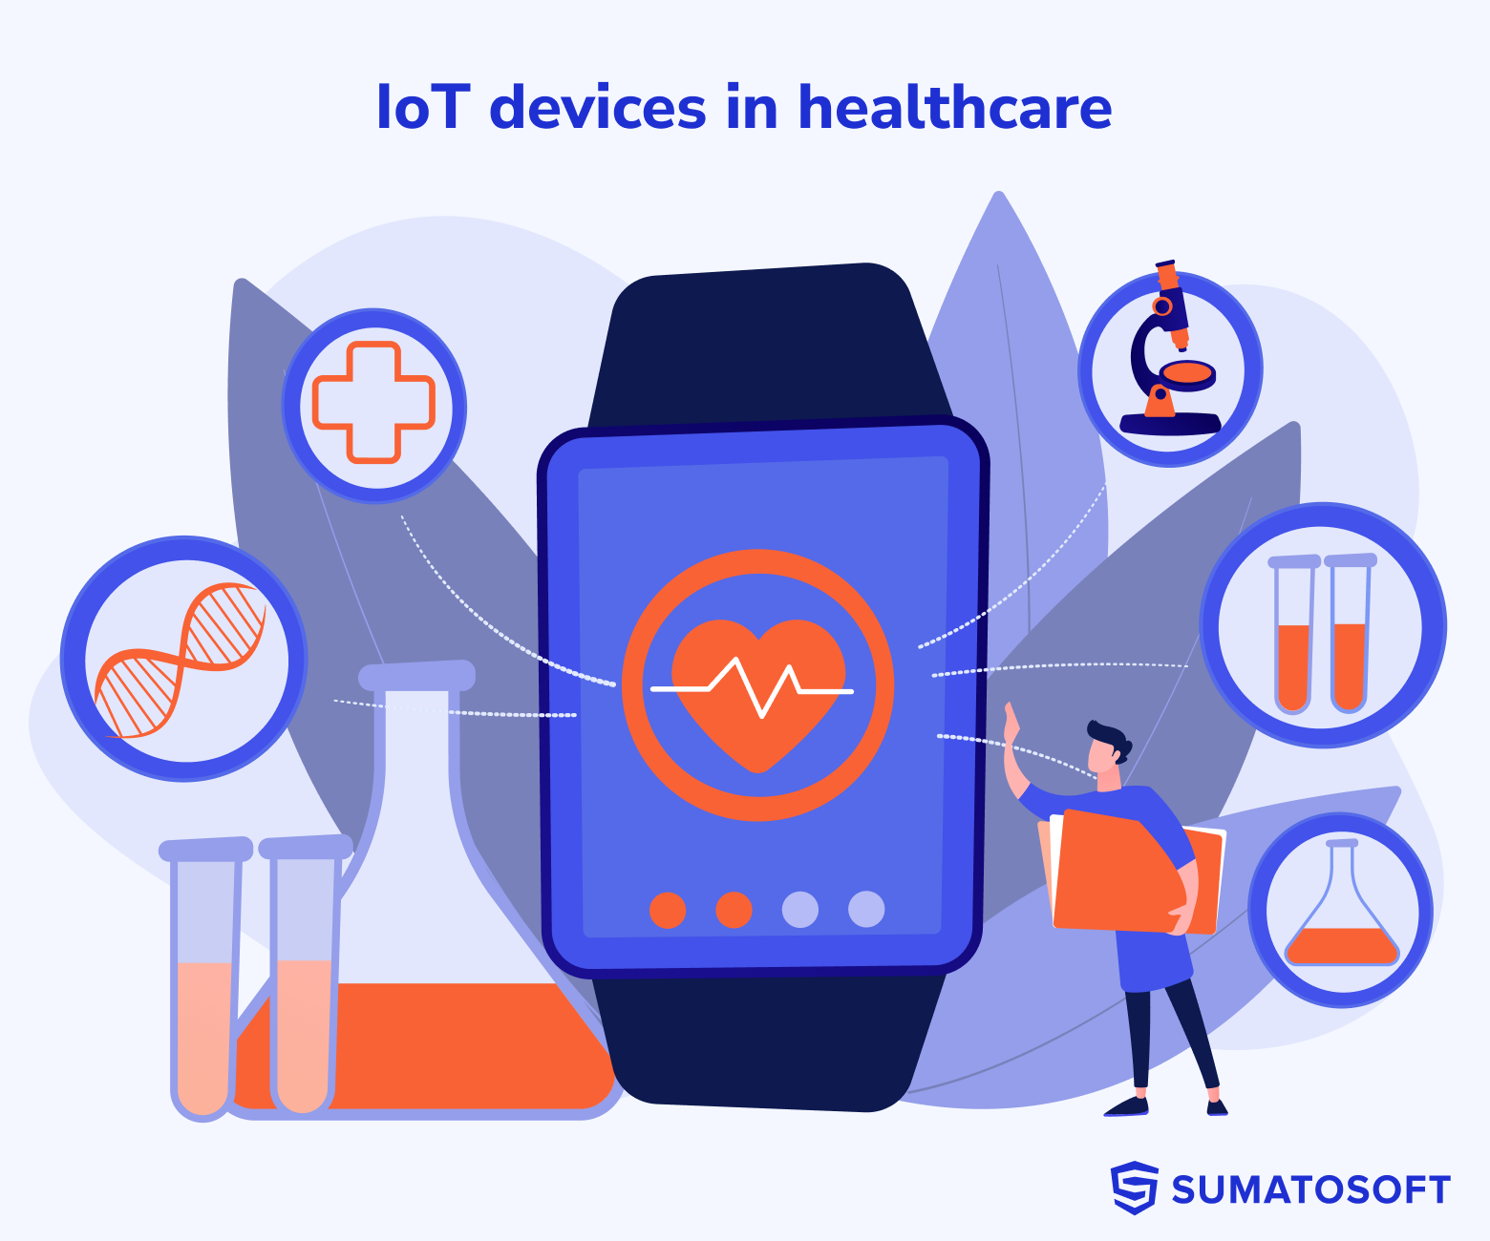
Literature Review
Introduction to IoT in Healthcare
In recent years, the integration of IoT technology into healthcare systems has garnered significant attention for its potential to revolutionize patient monitoring. IoT-enabled systems facilitate remote monitoring of patient health parameters, offering real-time data collection and analysis for improved healthcare outcomes
Significance and potential of IoT to revolutionize
healthcare systems
The seamless integration of IoT technology into healthcare not only improves the quality of patient care but also reduces healthcare costs and enhances overall efficiency. IoT-enabled healthcare systems enable proactive intervention, personalized care delivery, and remote patient monitoring, transforming traditional healthcare practices.

Slide 6
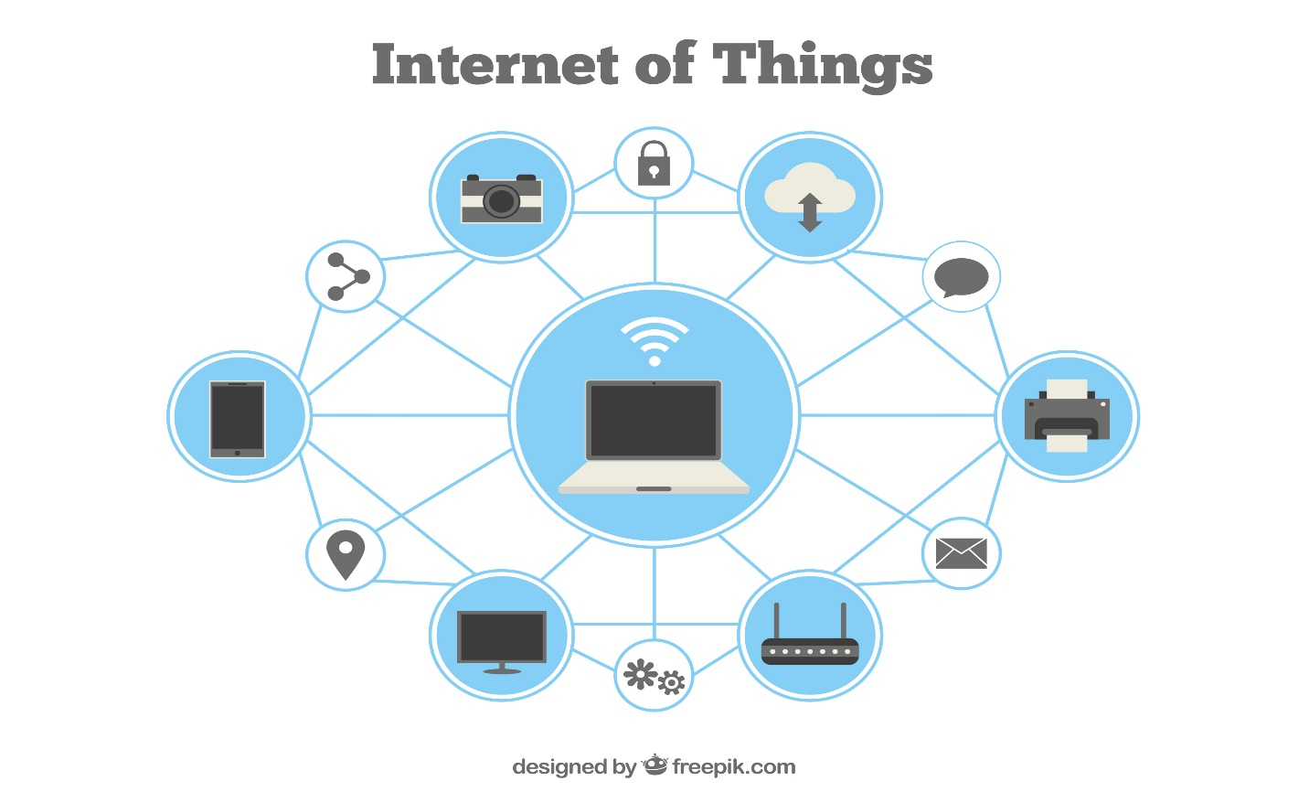
Literature Review
Existing Approaches in IoT-based Patient Health Monitoring
Existing research has explored various approaches to IoT-based patient health monitoring, showcasing a range of innovative solutions. Wearable IoT devices equipped with sensors continuously monitor vital signs, while cloud-based patient monitoring systems enable remote access to patient data for healthcare professionals.
Wearable IoT devices equipped with sensors offer a convenient and accessible way to continuously monitor vital signs such as heart rate, blood pressure, and body temperature. These devices enable real-time monitoring of patient health parameters, facilitating timely intervention and personalized care delivery.
Cloud-based patient monitoring systems leverage platforms like Raspberry Pi to enable remote access to patient data for healthcare professionals. These systems facilitate seamless communication and collaboration, enhancing the efficiency and effectiveness of healthcare delivery.

Slide 7
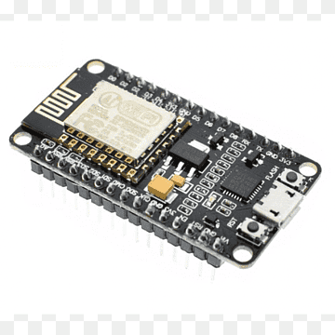
Literature Review
Advancements in Microcontroller Technology and Gap in Literature
Recent advancements in microcontroller technology, such as the ESP32 microcontroller, have opened new possibilities for remote patient monitoring. The ESP32 microcontroller offers built-in Wi-Fi and Bluetooth connectivity, enabling seamless data transmission and communication in patient monitoring systems
Example study: "ESP32 Microcontroller-Based Remote Health Monitoring System" (Journal of Medical Internet Research, 2022)
The paper "ESP32 Microcontroller-Based Remote Health Monitoring System" showcases the potential of utilizing microcontrollers like the ESP32 for real-time health monitoring applications. This study highlights the capabilities of the ESP32 microcontroller in facilitating remote patient monitoring and data transmission

Slide 8
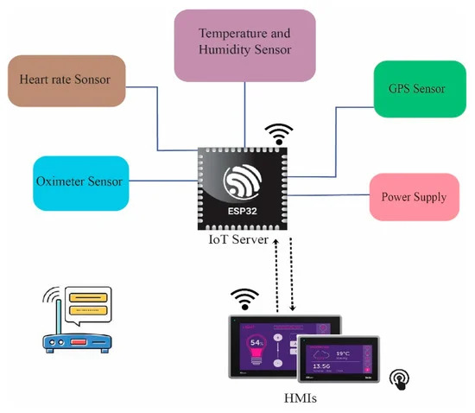
Working Method
Working Principle
The IoT-based Patient Health Monitoring project utilizes ESP32 development kits to monitor vital signs like pulse rate, temperature, and humidity remotely. ESP32 serves as both sensor controller and server, enabling real-time data processing and transmission via Wi-Fi to a web server. Healthcare professionals can access patient data stored in a centralized database from smart devices anywhere. Real-time alerts notify of abnormalities, enhancing timely interventions. This integration addresses challenges in IoT-based healthcare monitoring, advancing its adoption in real-world settings.
System Architecture

Slide 9
Working Method
Progress of work:
Wearable sensors continuously monitor vital signs (heart rate, temperature, humidity).
The ESP32 development kit on the wearable device transmits the sensor data securely via Wi-Fi.
The data is received by a web server and stored in a centralized database.
Healthcare professionals can access patient data remotely through any smart device.
The system generates real-time alerts for any abnormal readings, enabling timely interventions.
6.This system offers remote patient monitoring, reducing in-person visits and improving healthcare efficiency.

Slide 10
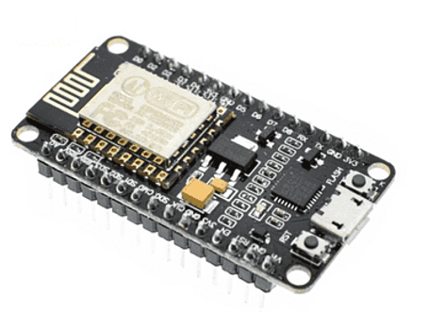
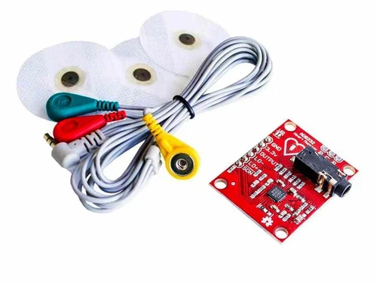
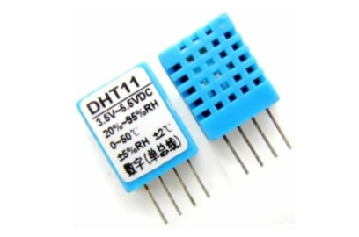
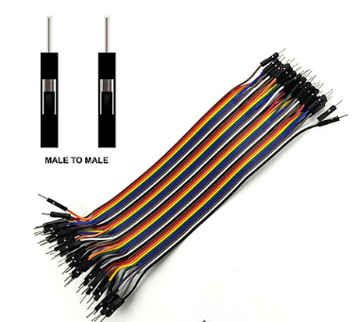
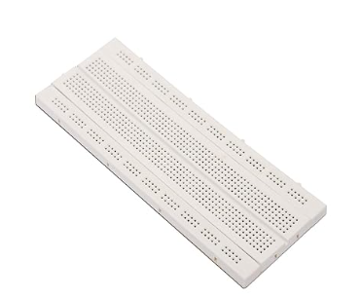
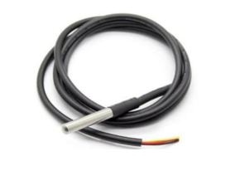
Description of the Components
DHT11 Humidity & Temperature Sensor
AD8232 Pulse Sensor
ESP32 Microcontroller
DS18B20 Temperature Sensor
Male To Male Jumper Wires
Breadboard

Slide 11
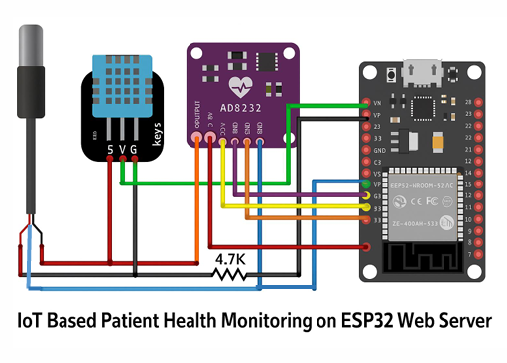
Description of the Diagram
The ESP32-based Patient Health Monitoring System uses AD8232, DHT11, and DS18B20 sensors to monitor vital health metrics like heart rate, temperature, and humidity. The AD8232 connects to GPIO21 and GPIO22 for heart rate saturation readings, DHT11 monitors ambient temperature and humidity, and DS18B20 provides additional temperature data for effective healthcare management.

Slide 12
Description of the Diagram
This system is built on a compact yet powerful hardware setup designed for remote health monitoring. The ESP32 microcontroller serves as the core unit, enabling sensor interfacing and seamless data transmission over Wi-Fi. To capture vital signs, the setup includes three key sensors: a pulse oximeter for detecting heart rate, an environmental sensor to measure surrounding temperature and humidity, and a digital temperature sensor for precise body temperature readings. Each component plays a distinct role in ensuring comprehensive health tracking. The integration of these modules with the ESP32 allows for real-time data acquisition, processing, and display on a web interface, making the system suitable for smart, connected healthcare solutions.

Slide 13
Equations/Mathematical Model
We calculate heart rate using the formula:
HeartRate = (beatCount × 60) / 5
This equation determines the number of heartbeats per minute (BPM) by counting the total beats (beatCount) detected over a 5-second interval, then scaling it to 60 seconds. It provides a real-time estimation of the heart rate from ECG sensor data.

Slide 14
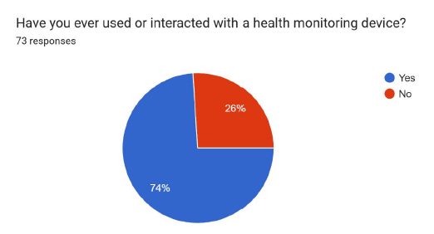
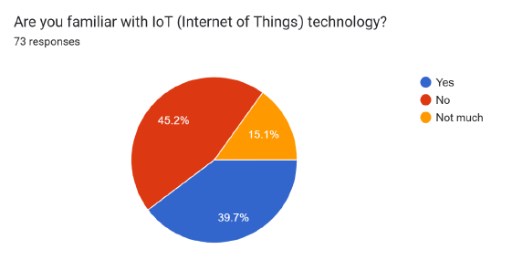
Survey Report
To better understand the potential adoption and effectiveness of a Remote Health Monitoring System based on ESP32 and IoT, we conducted a survey consisting of 10 questions, with responses from 73 participants. The goal was to gather insights on user attitudes toward remote health monitoring, familiarity with IoT technology, and preferences for health tracking features. The data collected helps to evaluate the feasibility and demand for such a system, as well as identify key factors that could influence user acceptance and satisfaction. The survey was conducted through the following link: Survey Link Below are the results from the survey, highlighting the participants' responses.

Slide 15
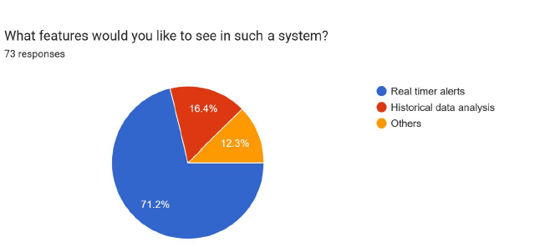
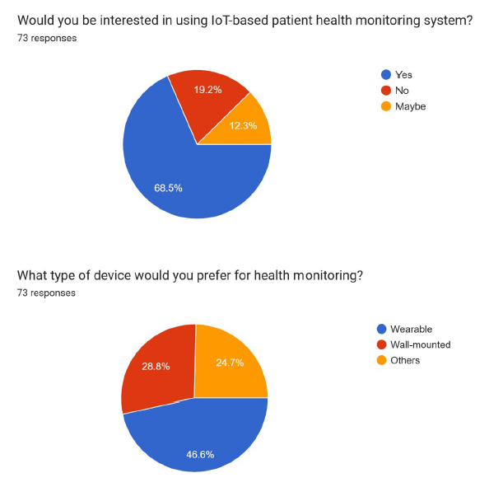
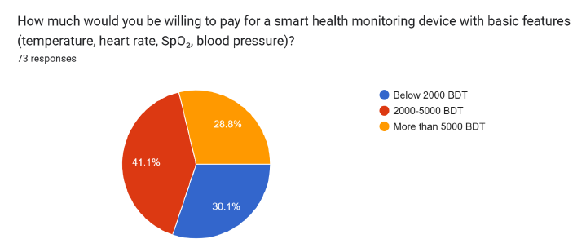

Slide 16
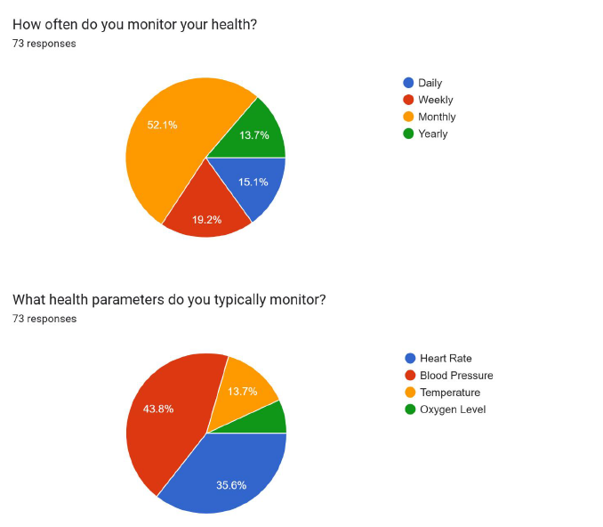
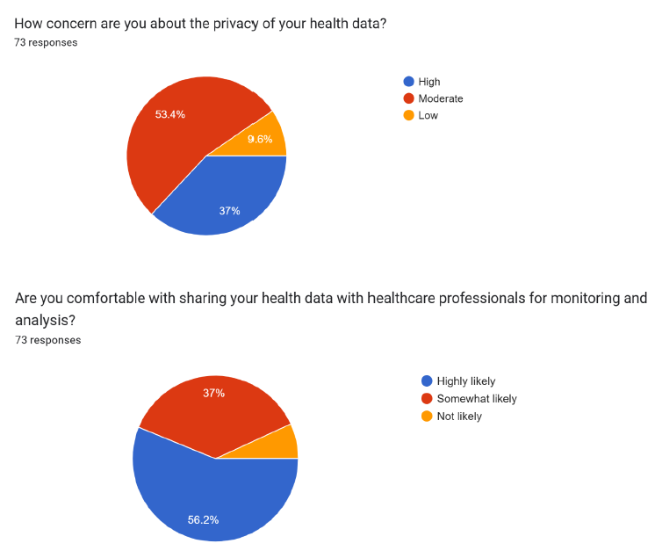

Slide 17
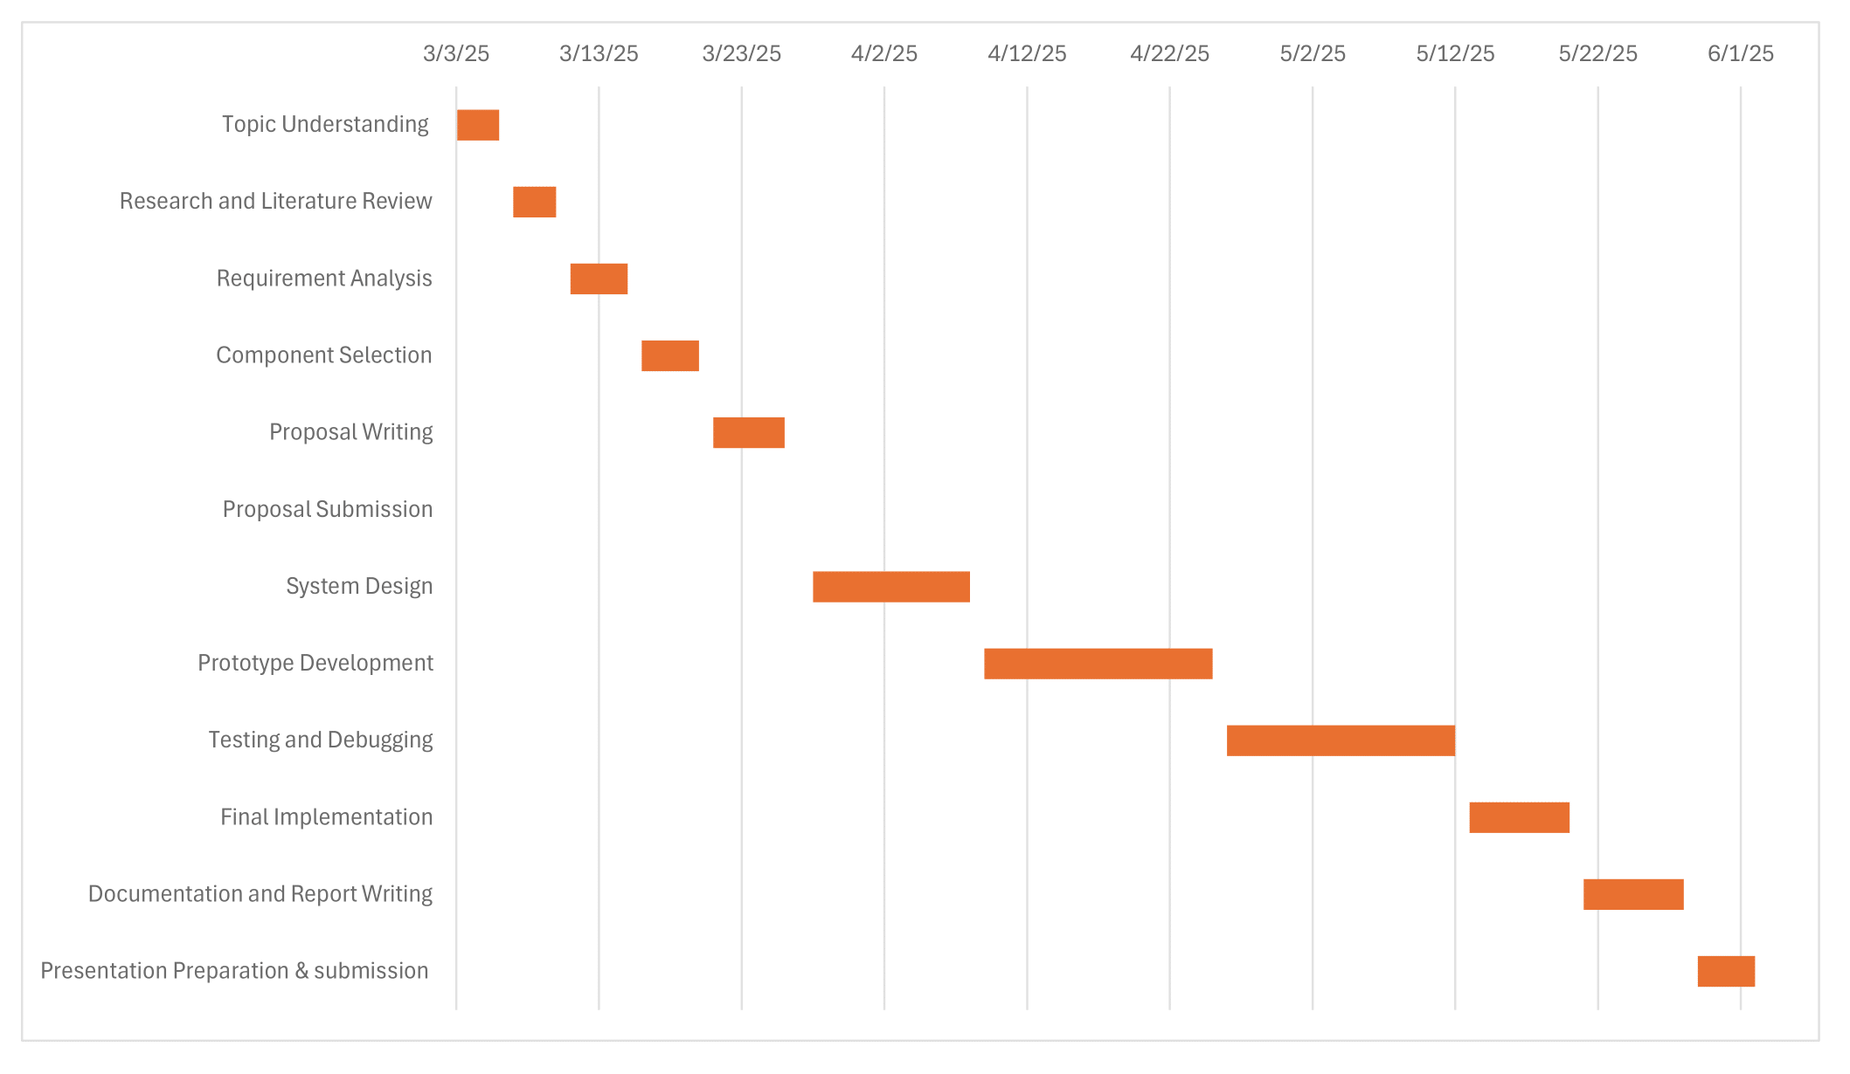
Gantt Chart
This Gantt chart outlines the project timeline, starting from topic selection on March 3, 2025, to the final presentation submission on June 1, 2025. It includes key phases such as literature review, component selection, system design, prototype development, testing, and documentation, ensuring a structured and organized workflow throughout the project.

Slide 18


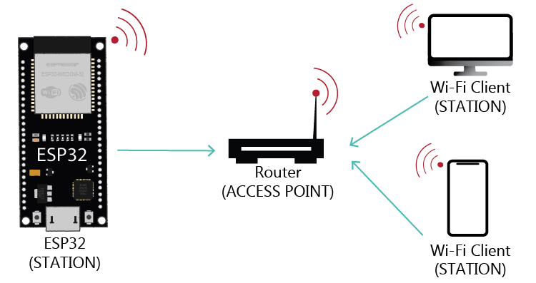
Results and Discussions
Results
The ESP32 successfully connects to the designated Wi-Fi network, and upon successful connection, it obtains an IP address, which is displayed on the serial monitor.
The system accurately measures and displays various health parameters, including room temperature, room humidity, heart rate (BPM), and body temperature. These readings are obtained using the AD8232 pulse oximeter sensor, DHT11 humidity & temperature sensor, and DS18B20 temperature sensor.

Slide 19
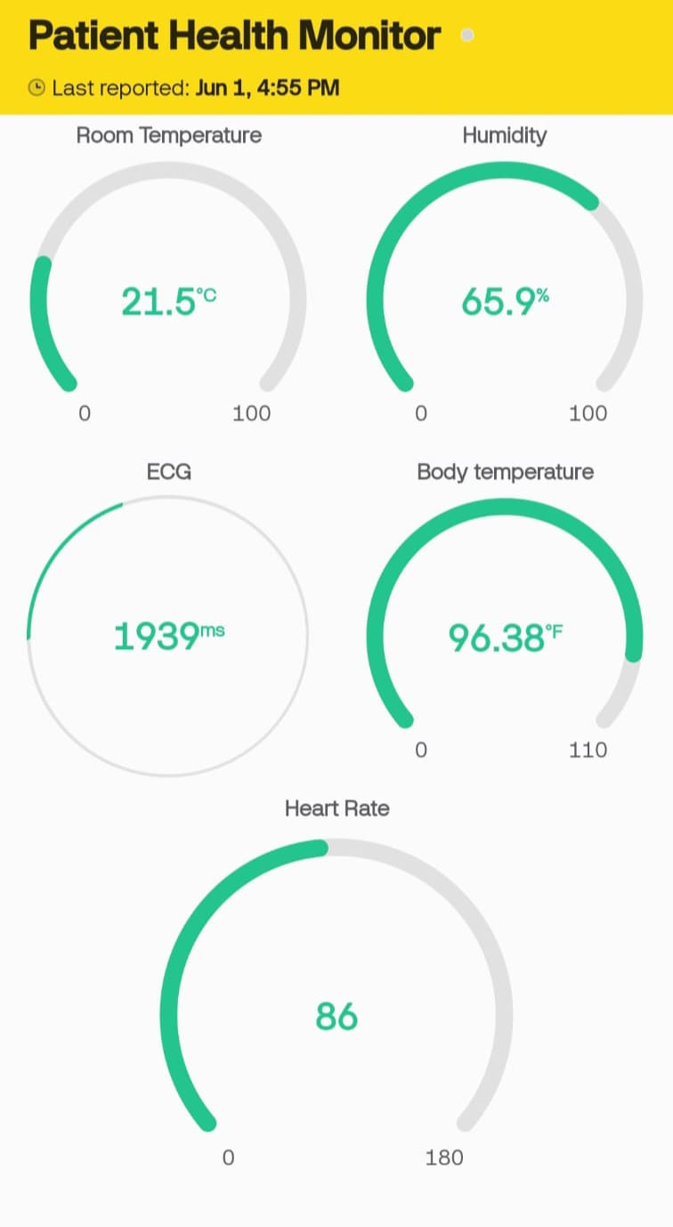
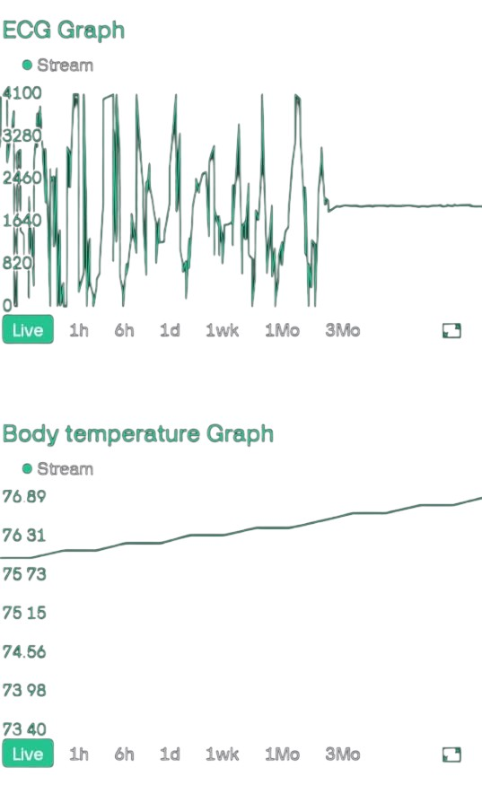
Results and Discussions
Results
Upon entering the IP address of the ESP32 into a web browser, a user-friendly web page is displayed. This page showcases the real-time health status of the patient, making it convenient for caregivers or medical professionals to monitor remotely.
The system is compatible with mobile devices, allowing users to access the patient's health status via a web browser on their smartphones or tablets.

Slide 20
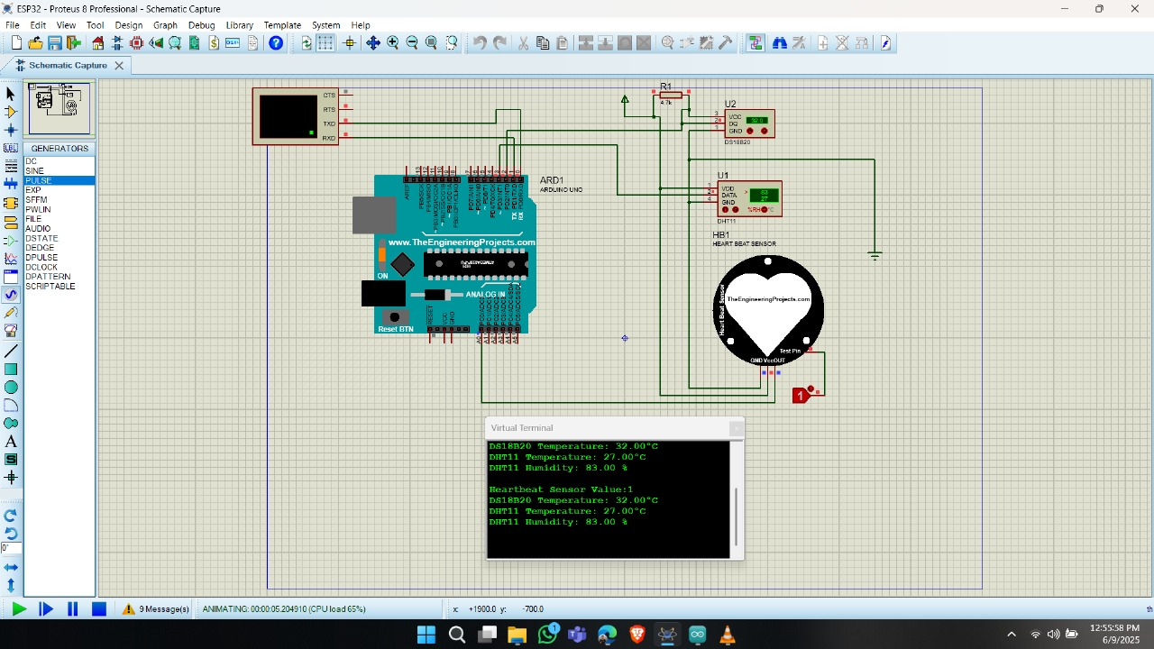
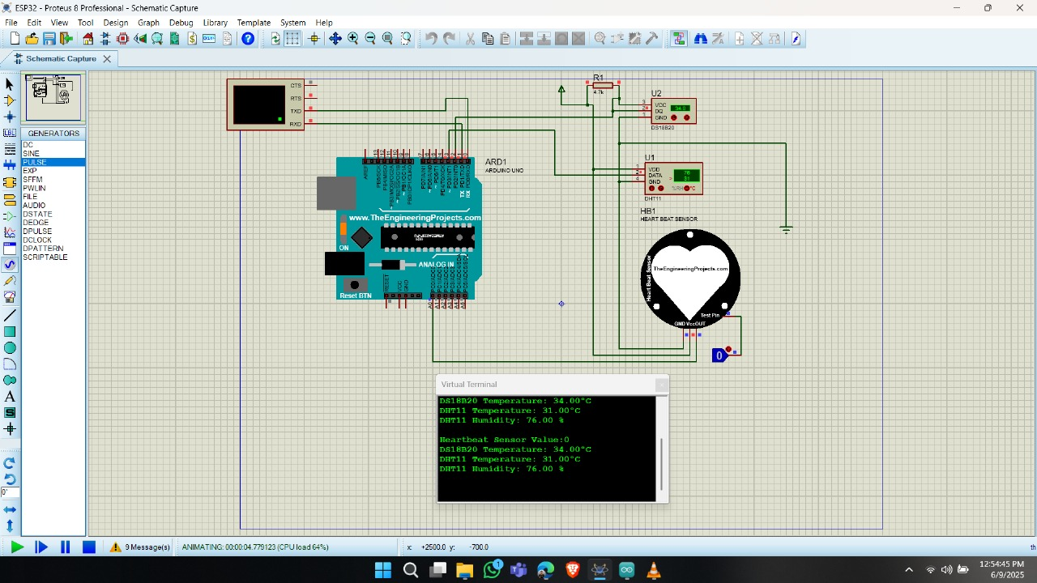
Results and Discussions
Simulation Result
The simulation showed successful real-time monitoring of temperature, humidity, body temperature, and ECG signals using ESP32. Sensor data was accurately displayed on both the Blynk app and the web server, confirming reliable performance. The system effectively supports remote health tracking.

Slide 21

Results and Discussions
Discussions
The accuracy and reliability of the sensor readings are crucial for effective patient monitoring. The AD8232 pulse oximeter sensor, DHT11 humidity & temperature sensor, and DS18B20 temperature sensor are chosen for their precision and consistency in measuring vital health parameters.
The ability to monitor patient health status in real-time is a significant advantage of this IoT-based system. Caregivers or medical professionals can promptly respond to any abnormalities or emergencies based on the live data provided by the system.
By hosting the health monitoring interface on a web server, the system ensures accessibility from any device with a web browser and internet connection. This accessibility enhances convenience for caregivers and enables remote monitoring of patients, even from a distance.

Slide 22
Results and Discussions
Discussions
The user interface of the web page is designed to be intuitive and easy to understand. Clear and concise presentation of health parameters facilitates quick interpretation of data, enabling efficient decision-making by caregivers or medical professionals.
The system can be scaled up to accommodate additional features or sensors for comprehensive patient monitoring. Future enhancements may include integration with mobile applications, data analytics for trend analysis, and alerts/notifications for critical health conditions.

Slide 23
Conclusions
CONCLUSION
In conclusion, the project successfully demonstrates the feasibility of implementing an IoT-based patient health monitoring system using ESP32 technology. By leveraging wireless connectivity and web-based interfaces, the system enables real-time monitoring of vital signs and remote access to patient data, offering significant benefits for healthcare delivery.
Despite its achievements, the project faces certain limitations. Challenges related to sensor accuracy, data security, scalability, and user interface complexity need to be addressed to enhance the reliability, privacy, and usability of the system in real-world scenarios.

Slide 24
Future Scopes
Future Scopes
Advanced Sensor Technology: Explore innovative sensor technologies to enhance accuracy and reliability, including wearable biosensors and machine learning integration.
Blockchain Data Security: Investigate blockchain integration for secure and tamper-proof storage of patient data, ensuring privacy and protection against unauthorized access.
Cloud Scalability: Develop cloud infrastructure for scalable deployment across multiple healthcare facilities, optimizing resources and enabling seamless expansion.
User-Centric Design: Conduct user feedback sessions to improve interface usability, incorporating customizable features and intuitive navigation.
Telemedicine Integration: Integrate with telemedicine platforms for remote consultation, fostering collaboration between patients and healthcare providers.

Slide 25
Thanks for listening our presentation….
?

